Slide 1

ITP: new drugs & immune insight EHA 2025
Dr. Aya Alsyaleh
Hematologist
Damascus hospital

Slide 2
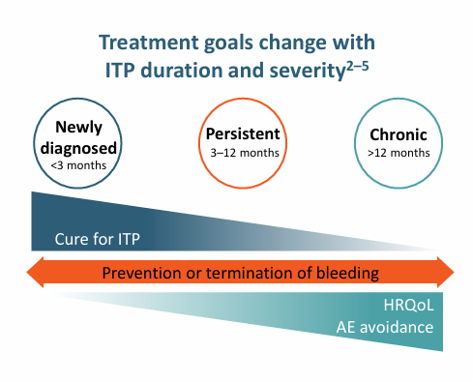
ITP is a dynamic, evolving disease
ITP has a substantial impact on patients’ daily activities and emotional well-being
ITP World Impact Survey, Physician perspectives (N=472):
80% reported ITP symptoms reduced patient HRQoL
ITP treatment goals aim to individualize treatment,
prevent severe bleeding, and improve HRQoL
First-line treatments (Corticosteroids, IVIg)
are used for newly-diagnosed patients.

Slide 3
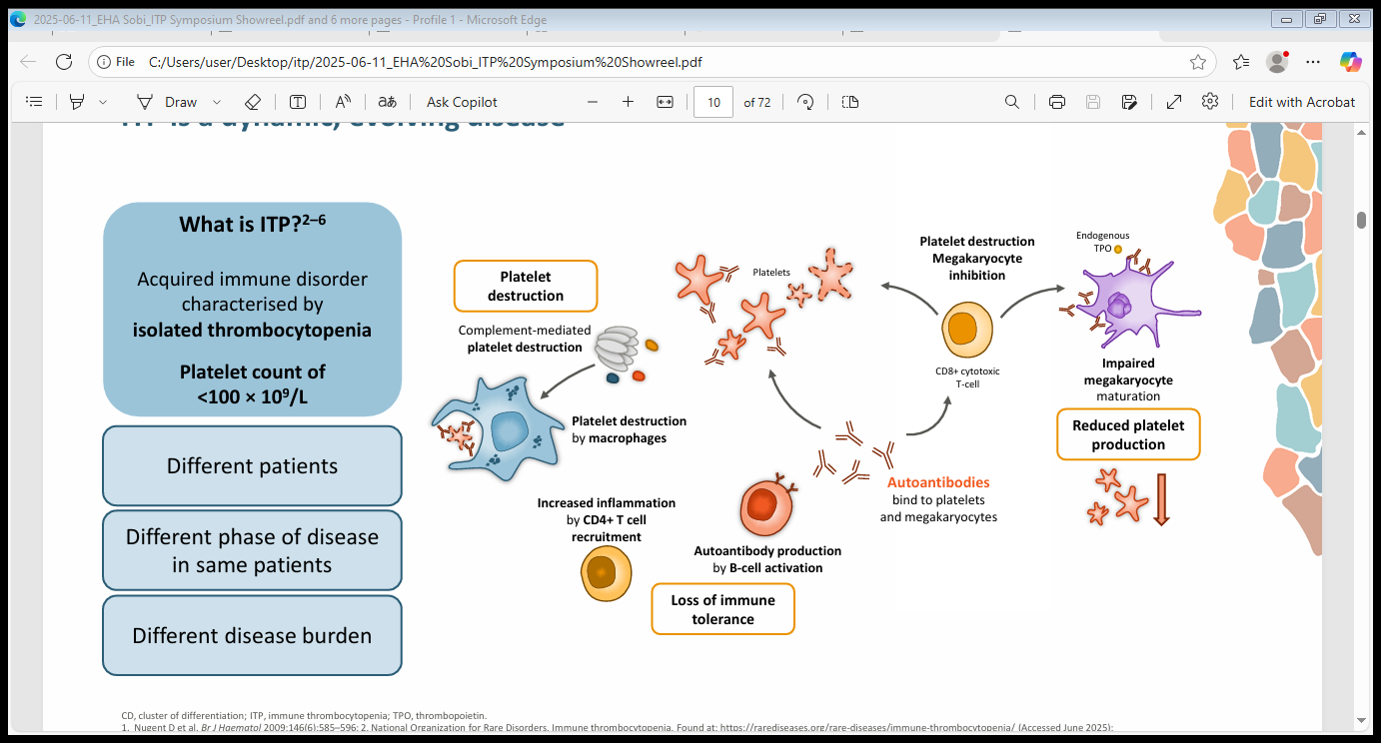
What is ITP?

Slide 4
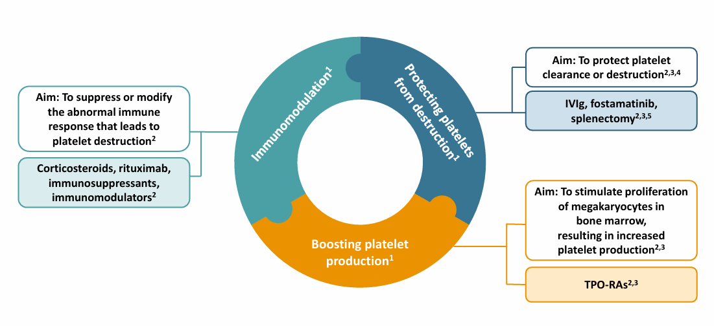
ITP treatment strategies

Slide 5
When, why, and how to treat after first-line
Second-line treatments are intended for patients who are refractory to first-line therapy or who have persistent or chronic ITP.
Limited guidance in guidelines on selection of second-line treatment
RWE: Early switch to TPO-RAs can improve long-term clinical outcomes
These agents are highly effective, with overall response rates of approximately 75% and durable responses in about 65% of patients
Up to 30% of patients with ITP maintain a sustained response after TPO-RA dose reduction or discontinuation.
Approximately 15% of patients do not have a durable response after 3 lines of therapy

Slide 6
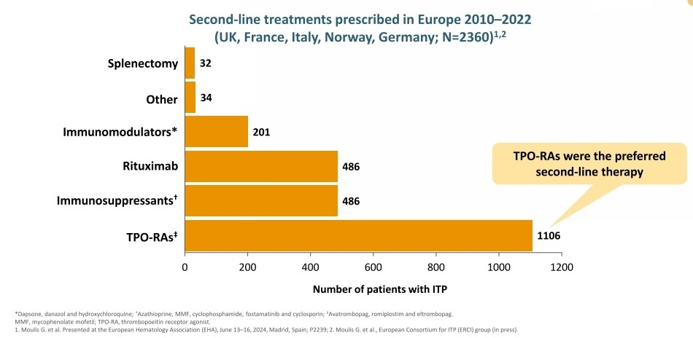

Slide 7
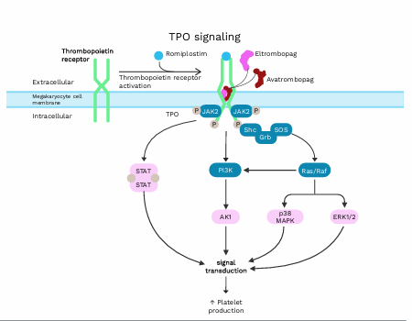
TPO-RAs: Eltrombopag ,Romiplostim, Avatrombopag?
Choice is based on efficacy, safety profile, patient preference and comfort/supervision

Slide 8
Real-World Outcomes of Avatrombopag Treatment in Primary ITP Stratified by Prior TPO-RA Exposure: Results of the REAL-AVA 2.0 Study
review study of adult patients with primary ITP who initiated AVA treatment between July 1, 2019 and June 30, 2024.
A total of 177 patients from 11 US-based medical centers
Median time from ITP diagnosis to index date was 2.2 years.
The median number of ITP treatments received prior to AVA initiation was 3.0.
Prior to the index date, 90 patients (50.8%) had received eltrombopag and 66 (37.3%) had received romiplostim; 42 patients (23.7%) had been treated with both agents.
At AVA initiation, 40 (22.6%) patients had a baseline PC < 30k/µL, 84 (47.5%) had PC < 50k/µL, and 137 (77.4%) had PC < 100k/µL.
Among responders, duration of follow-up ranged from 19.2-20.7 months, and duration of AVA treatment ranged from 13.5-17.2 months across response thresholds
Among responders, response was maintained for a median of 12.0 , 12.1 , and 9.7 months at the ≥30k/µL, ≥50k/µL, and ≥100k/µL thresholds, respectively.

Slide 9
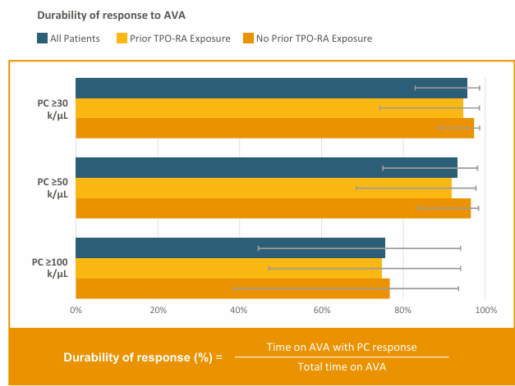
AVA was associated with high rates of durable response across PC response thresholds, with a median response durability of 95.7% at PC≥30k/µL, 93.2% at PC ≥50k/µL and 75.5% at PC ≥100k/µL.

Slide 10
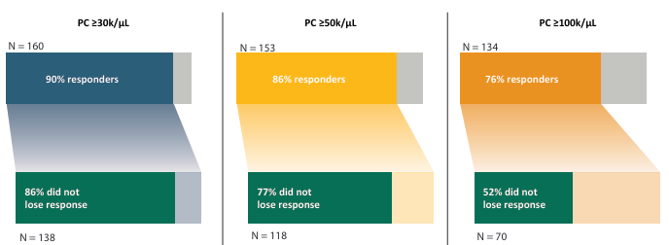
Most patients who achieved or maintained PC response at each threshold did not experience any loss of response:

Slide 11
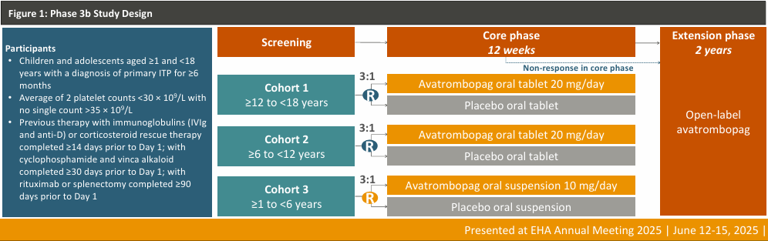
Results from the Phase 3b Multicenter, Randomized, Double-Blind, Placebo (PBO)-controlled, Parallel-group Trial

Slide 12
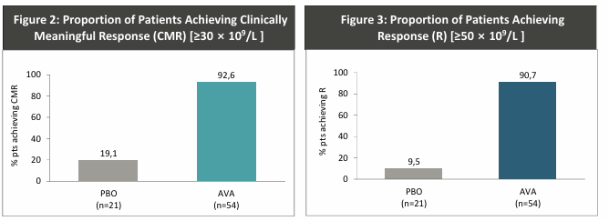
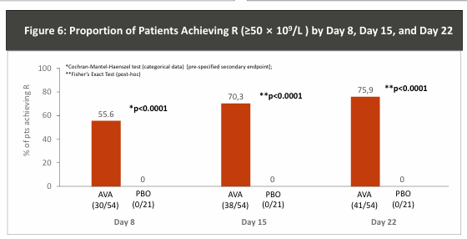

Slide 13
THROMBOTIC ADVERSE EVENTS IN PATIENTS RECEIVING TPO-RAs : a EUROPEAN MULTICENTER STUDY
This study included data from 267 patients who initiated TPO-RA therapy between January 2014 and December 2018 across 16 institutions in six European countries.
A total of 417 TPO-RA treatment courses were analyzed, including 267 first-course, 113 second-, and 37 third-course TPO RA therapies.
Eltrombopag was used in more treatment courses (258) than romiplostim (159), and thrombotic event rates were similar: 7.2 and 7.7 events per 100 patient-years, respectively.
Among the 35 vascular AEs observed in 31 patients, 51% were arterial and 49% were venous, including embolism and deep vein thrombosis.

Slide 14
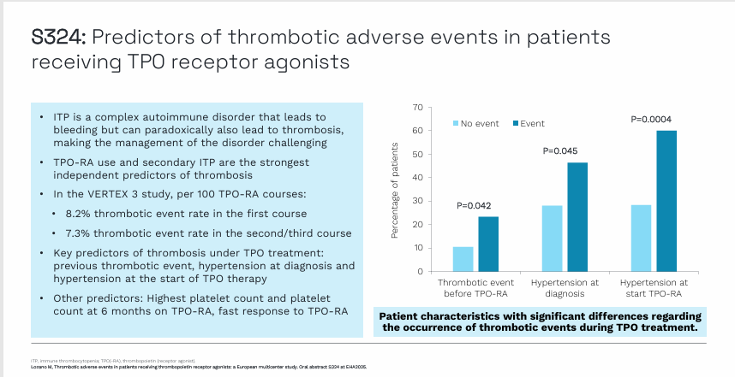

Slide 15
Sustained response off treatment (SROT) after TPO-RAs
Following TPO-RA discontinuation, 51.7% of first-course TPO-RA patients did not require additional ITP treatments, compared to 40.3% of those treated in second- and 26.1% in third-course therapy (median follow-up 66, 52.5, and 48 months, respectively).
Reintroduction of TPO-RA was required in 28.0% of first-course patients, increasing to 34.8% in second-course and 37.5% in third-course TPO-RA cases.
Notably, patients who had received TPO-RA for over a year were significantly less likely to require reintroduction than those treated for shorter durations (18.9% vs. 35.2%, p=0.045).
Unlike platelet count at six months from TPO-RA initiation, which was a strong predictor of SROT, platelet count at diagnosis was inversely correlated with the likelihood of achieving SROT.

Slide 16
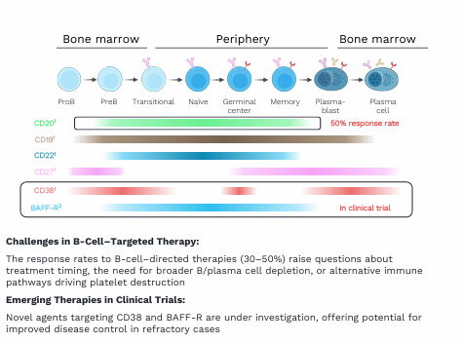
B-cell-targeted therapies and beyond in ITP

Slide 17
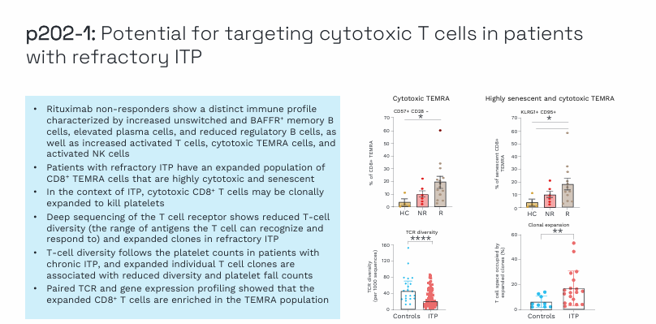

Slide 18
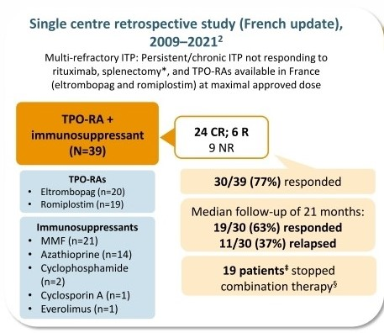
Combining TPO-RAs + immunosuppressants?
T-cell–targeted therapies such as MMF, have response rates of 30–50% and are often poorly tolerated
CD8⁺ TEMRA cells are reduced in patients who respond to eltrombopag
Eltrombopag is a potent iron chelator and shuttler shown to exert anti-proliferative effects on leukemic cells and inhibit proliferating CD8⁺ T cells

Slide 19
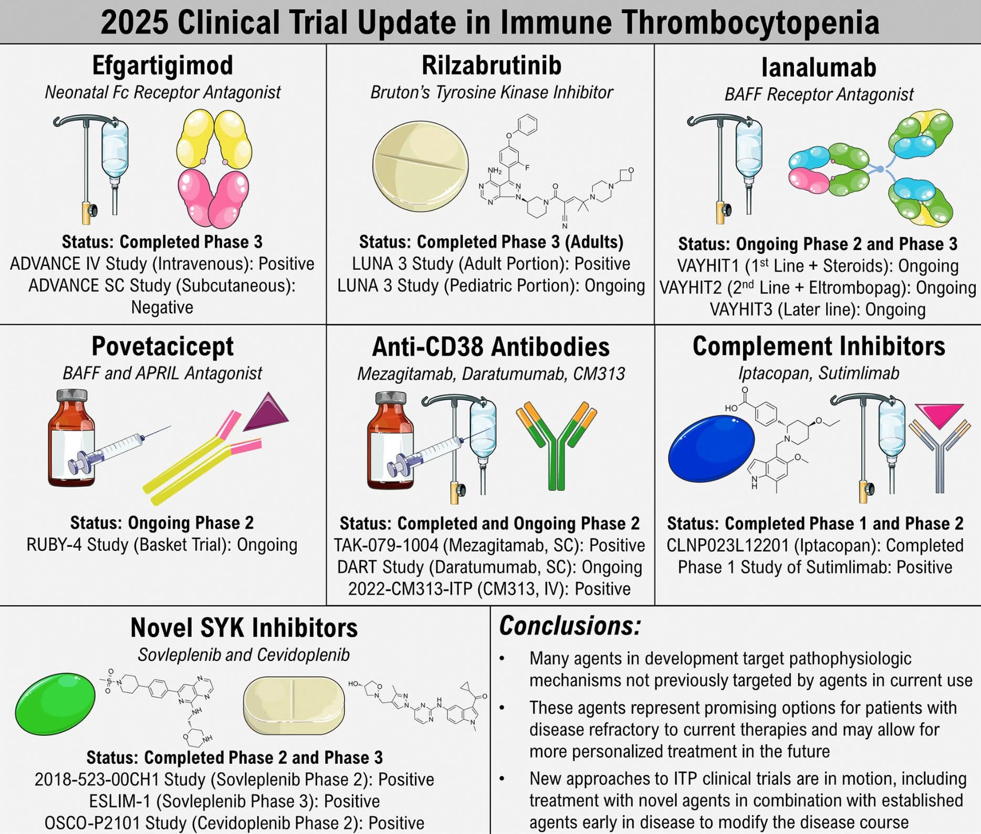

Slide 20
Rilzabrutinib :
is a reversible covalent, highly selective Bruton tyrosine kinase inhibitor that acts through multi-immune modulation
Paris, August 29, 2025 – FDA has approved Wayrilz (rilzabrutinib) for adults with persistent or chronic (ITP) who have had an insufficient response to a previous treatment
the approval based on Phase 3 LUNA3 study

Slide 21
Phase 3 LUNA3 study:
Adult patients with persistent or chronic ITP and severely low platelet counts (median of 15,000/μL) received oral rilzabrutinib 400 mg twice a day (n=133) or placebo (n=69) for up to 24 weeks followed by 28 weeks of open-label period :
The primary endpoint of durable platelet response, able to achieve platelet counts at or above 50,000/μL for at least 8 out of the last 12 weeks of the blinded treatment period in the absence of rescue therapy was met in 23% (n=31) of patients receiving rilzabrutinib compared to 0% of patients on placebo
Patients on rilzabrutinib were approximately three times more likely to achieve a platelet response than patients on placebo
Among responders on rilzabrutinib, median time to response was 15 days
Rilzabrutinib significantly reduced the need for rescue therapy by 52% compared to placebo

Slide 22
Long term extension period (LTE) with Rilzabrtinib in adults:
At baseline, these 69 LTE patients had a median age of 52 years, 73% were female, median duration of ITP was 9.6 years, median of 4 unique prior therapies (26% splenectomized).
Median platelet count at LTE entry was 113/μL and median platelet counts ranged from 84-136/μL for the first 12 months of the LTE .
Complete response (platelet count ≥100/μL ) was achieved in 37 (54%) LTE patients. Rilzabrutinib treatment during the LTE further improved physical fatigue and bleeding score based on mean changes from baseline.
Of 47 (68%) patients receiving concomitant ITP medication during the LTE, 11/47 (23%) discontinued concomitant medication and remained on rilzabrutinib monotherapy, 16/34 (47%) decreased CS dose >50% from baseline, and 15/27 (56%) reduced their dose or stopped TPO-RA from baseline.
All treatment-related AEs were G1 or G2, nausea (7%), diarrhea (4%),upper abdominal pain(2%)

Slide 23

Thank you

